Slide 1

Azul Checkpoint #2
Group 5

Slide 2
Contents
01
Checkpoint #1 Feedback
02
How we addressed the feedback
03
Research Questions
04
What we have done since checkpoint #1
05
Current findings from the updated notebook
06
Next analyses and questions for Azul

Slide 3
Checkpoint #1 Feedback
Problem 1
Problem 2
The first presentation did not show enough of the filtering process.
We also did not compare flights fairly enough inside similar operating conditions, especially around TOW.
As a result, it was hard to see whether the patterns reflected real operating behavior or sample noise.
Fuel efficiency was still described too broadly and not in an operationally actionable way.
It was difficult to tell exactly what had been done since the first checkpoint and whether the analysis was moving toward implementable route-level decisions.
The recommendations still needed a clearer link between evidence, comparability, and action.
Response: make the filters visible, compare aircraft only in overlap conditions, and move from broad fuel commentary to seat-adjusted route-level evidence.

Slide 4
How we addressed the feedback
1. Show filter impact
2. Make fair comparisons
Added aircraft-level filtering counts and before-vs-after logic so the audience can see how much data is retained and why.
Compared aircraft only inside overlapping TOW conditions, especially E1 vs E2 and A320 vs A321, instead of relying on broad cross-fleet visuals.
3. Define operating windows
4. Move toward action
Introduced sweetspot ranges based on the best-performing 50% of flights per aircraft to make optimal operating conditions measurable.
Added route-overlap and seat-adjusted screening so swap ideas are evaluated on both fuel and approximate capacity fit.
The story is now: clean the data → compare aircraft under similar conditions → define sweetspots → test route-level substitution after capacity screening

Slide 5
Research Questions
?
Main research question
How can Azul identify implementable aircraft reassignment strategies across route groups with
overlapping operational sweet spots in order to improve operational efficiency without assuming
full fleet replacement?
☷
Subquestions
⌕
Questions based on methodology,
validation, or limitations
1.
Which city pairs or route groups exhibit overlapping operational
sweetspots between aircraft types, making reassignment
operationally plausible?
Whether payload composition may explain part of the
observed differences between aircraft types.
2.
To what extent do demand fluctuations across routes or seasons
justify the reassignment of aircraft types within these overlapping
sweetspots?
Whether the selected variables are appropriate for
comparing operational fit.
3.
How do airport infrastructure and operational constraints limit the
feasibility of using larger or alternative aircraft types on specific routes?
Whether the analysis contains blind spots or biases.
4.
How much potential benefit could these reassignment strategies
generate for the airline, based on the operational metrics available
in the dataset?
Whether seat count is an adequate proxy for swapability.
5.
How sensitive are the identified reassignment opportunities to the
analytical assumptions used, particularly seat-based swapability,
sweetspot thresholds, and sample size?
Whether the joint sweetspot sample is large enough to
support meaningful conclusions.

Slide 6
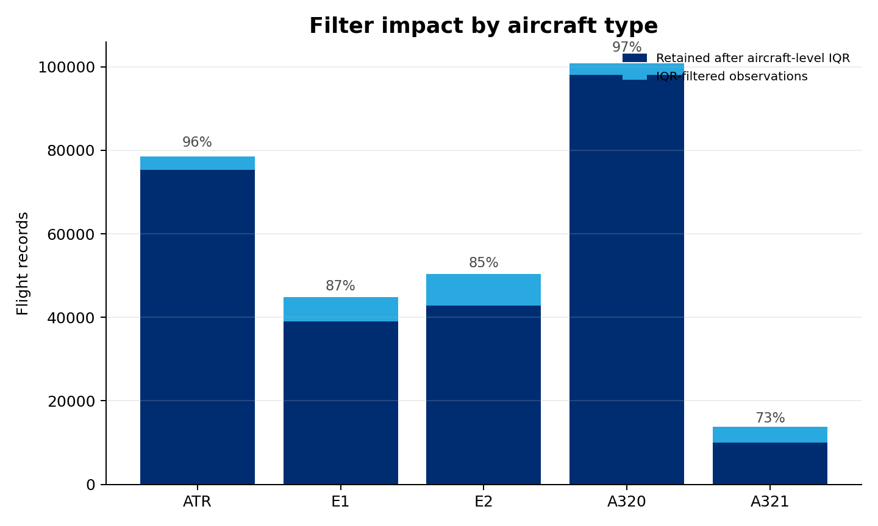
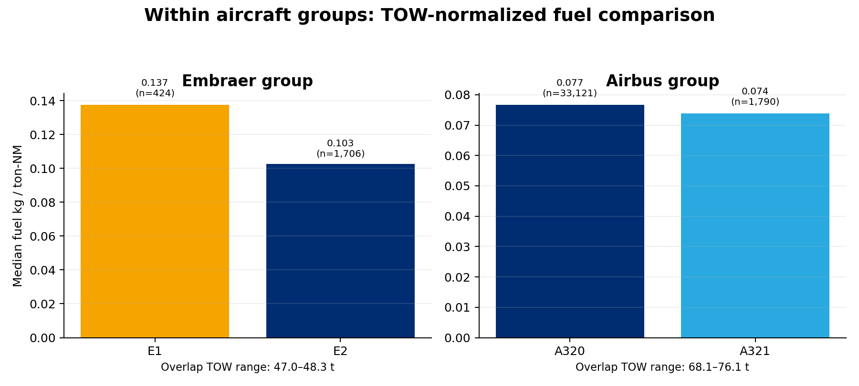
What we have done since checkpoint #1
Aircraft-level filter impact
TOW-normalized comparison inside overlap bands
What these additions changed
The IQR filter retains most of the sample while removing noisier tails, especially in E1, E2, and A321.
Inside shared TOW conditions, E2 is clearly more efficient than E1, which gives us a fairer within-family benchmark.
Inside the Airbus overlap, A320 and A321 look much closer, so any swap claim must pass a capacity screen and not rely on fuel-only evidence.

Slide 7
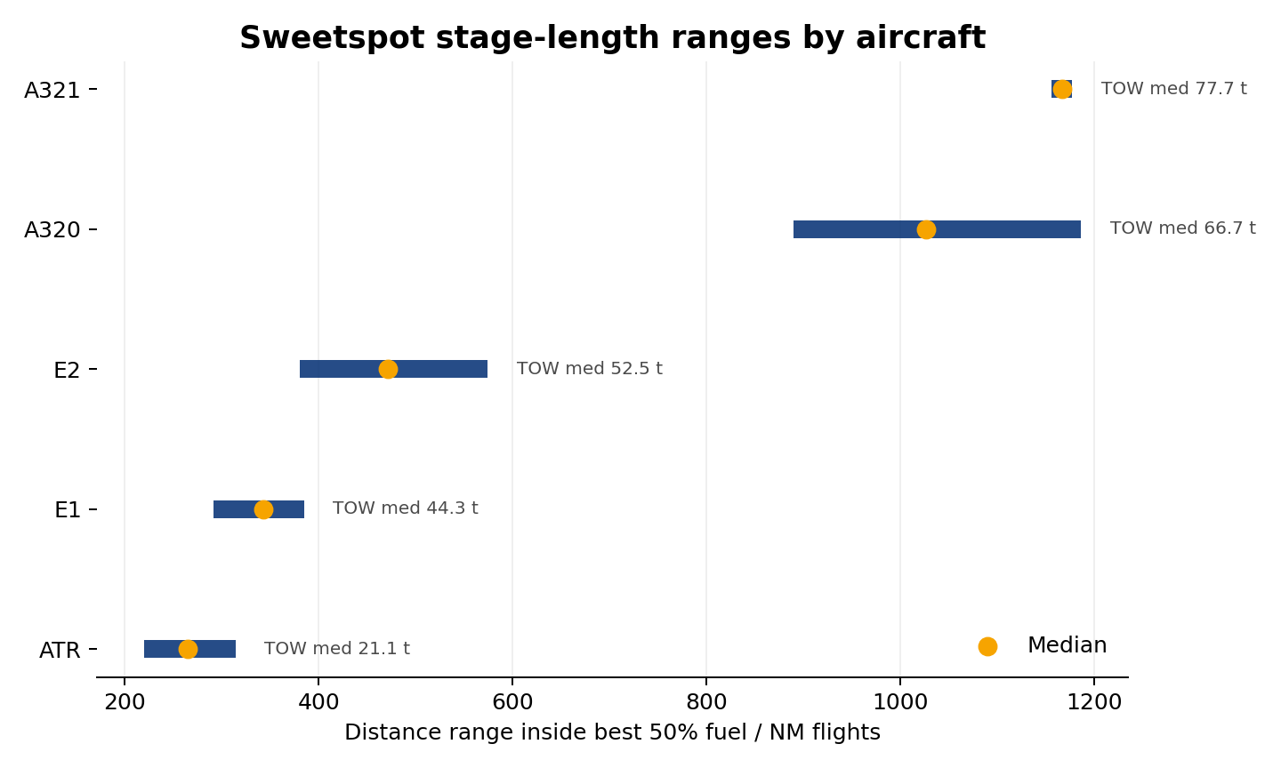
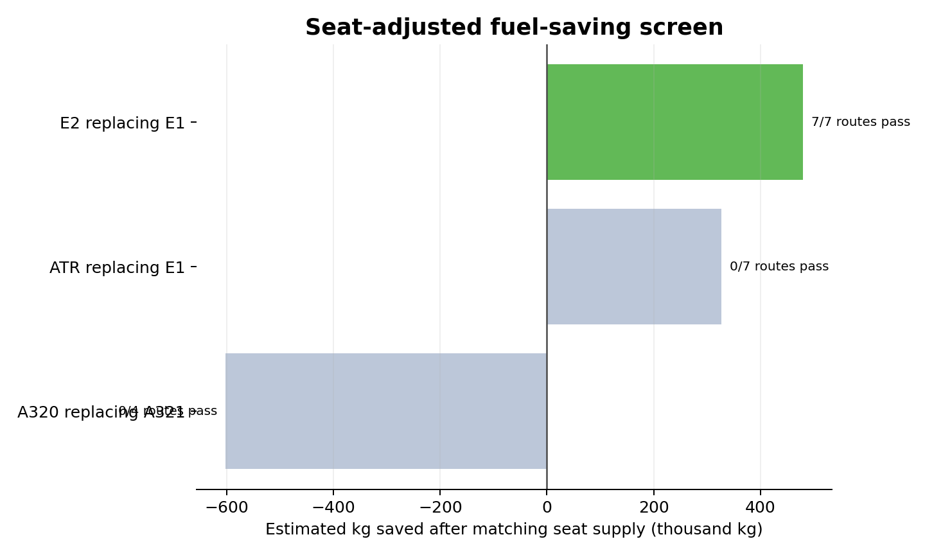
Current findings from the updated notebook
Observed sweetspot ranges by aircraft
Seat-adjusted substitution screen
What the current evidence suggests
Observed sweetspots separate aircraft naturally by stage length: ATR 221–321 NM, E1 308–482, E2 442–841, A320 889–1,188, and A321 1,156–1,199.
Fuel-only overlap routes suggest three possible swap directions: A320 replacing A321, ATR replacing E1, and E2 replacing E1.
After matching approximate seat supply, only E2 replacing E1 remains viable across all 7 candidate routes, with about 480 thousand kg of potential savings in the observed overlap sample.

Slide 8
Next analyses and questions for Azul
What we are doing now
Questions and data that would help
What we are doing now
Questions and data that would help
Questions and data that would help
Route-group trade studies inside overlapping sweetspots
Seasonality by city pair, route type, and stage-length band
Airport and operating-constraint checks for feasible reassignment
Theoretical fuel model and scenario-based savings estimation
Are route additions, removals, or major seasonal shifts already planned?
Which routes already operate with more than one aircraft type in practice?
Are there airport, payload, or scheduling constraints that would block reassignment?
If available: demand/load factor, payload mix, and direct operating cost data
• Route-group trade studies inside overlapping sweetspots • Seasonality by city pair, route type, and stage-length band • Airport and operating-constraint checks for feasible reassignment • Theoretical fuel model and scenario-based savings estimation
• Are route additions, removals, or major seasonal shifts already planned? • Which routes already operate with more than one aircraft type in practice? • Are there airport, payload, or scheduling constraints that would block reassignment? • If available: demand/load factor, payload mix, and direct operating cost data
• Are route additions, removals, or major seasonal shifts already planned? • Which routes already operate with more than one aircraft type in practice? • Are there airport, payload, or scheduling constraints that would block reassignment? • If available: demand/load factor, payload mix, and direct operating cost data
Team ownership by current workstream
Burak
Robert
Alexandre
Eduardo
data cleaning, sweetspots, overlap definitions
comparative visuals, route groups, storyline
constraints, synthesis, Azul-facing recommendations
capacity screen, theoretical model, savings scenarios

Slide 9
Legend
RACI matrix project management
A = Accountable
C = Consulted
I =
Informed
R = Responsible
 | Burak | Robert | Alexandre | Eduardo
Data foundation and cleaning | R | A | I | C
Checkpoint #1 refinement and visualization updates | C | I | A | R
Deep-dive analyses: sweetspots, route groups, seasonality | A | A | C | R
Optimization modeling: theoretical fuel model, capacity screen, savings | C | R | A | I
Final synthesis: recommendations and presentation story | R | C | C | A

Slide 10
Any questions?
?
Ask away!
Thanks for the attention!!

Slide 11
Project roadmap and work division
Step 01
Step 02
Step 03
Step 04
Goal
Deep-dive analyses Burak + Robert Sweetspots, route groups, and seasonal trade studies .
Optimization modeling Eduardo + Alexandre Theoretical fuel model, capacity screen, savings
Data foundation Burak + Eduardo Cleaning, assumptions, and comparable TOW bands
Checkpoint #1 refinement Robert + Alexandre Clearer visuals and more comparable evidence
All four members Actionable reassignment options and final story

Slide 12
Planned Analysis: Relations and Evidence
1. Data filtering and validation
2. Within-aircraft operating relations
• Filtering count chart and before-vs-after scatterplots to show how cleaning changes the dataset and improves reliability.
• Scatterplots with trend lines for TOW vs fuel burn, distance vs trip time, and trip time vs fuel burn to identify operating profiles and efficiency deterioration points.
3. Comparable aircraft-to-aircraft analysis
4. Route and seasonal trade studies
• Overlay scatterplots, sweetspot range charts, and capacity-screening tables to compare aircraft only in overlapping TOW, distance, and route conditions.
• Route heatmaps, monthly trend charts, and route-group comparison tables to test where reassignment is operationally realistic.

